Slide 1
Predicting the popularity of merchandise by creating the machine learning classification model
Team 8
SIDDHARTH PARAAG NILAKHE
MEHUL SUDHAKAR INGALE
PREETI REDDY KOPPOLU
Under the guidance of
Prof. Shucheng Yu

Slide 2
Problem Description
Big Brands spend a significant amount on popularizing a product.
Efforts go in vain while establishing the merchandise in the hyperlocal market.
Based on different geographical conditions same attributes can communicate a piece of much different information about the customer.
We will be solving this problem by using various machine learning algorithms.

Slide 3
Dataset Description
Basket-Ratio - Number of items getting sold in a single purchase.
Score-1, score-2, score-3, score-4 - Four types of scores allocated to the merchandise that affect the popularity directly or indirectly.
Store-score - Score given to a particular store based on several factors.
Store-presence - Presence of the store in the market with respect to others.
Time - Time spent in popularizing the merchandise.
Popularity - Target variable

Slide 4
Preprocessing techniques
Removing rows with null values.
Adding a new column called time of day which is derived from the time column.
Encoding the Category 1, Category 2, and time of day columns using one hot encoding.
Scaling the Store Ratio, Basket Ratio, and Store Score columns using min max scaling .
Then we call the clean data function on both the train and test data frames and assign the returned values to the variables X train, X test, y train, and y test.
Duplicates were eliminated from the dataset.
Changed the unit of time from seconds to years, days, hours, and minutes
Scaled the features ”Store Ratio,” ”Basket Ratio,” ”Store Score,” ”Store Presence,” ”Score 1,” ”Score 2,” ”Score 3,” and ”Score 4”.

Slide 5
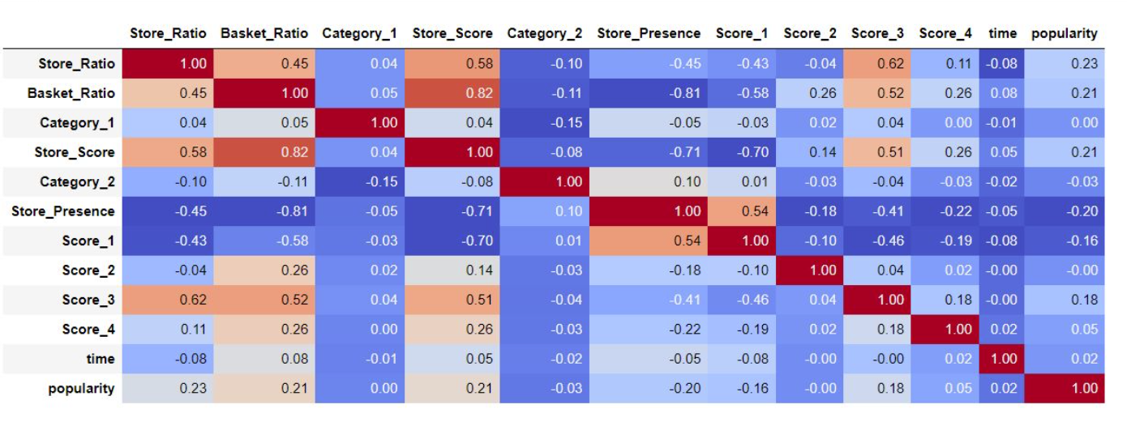
Exploratory Data Analysis
Heat map

Slide 6
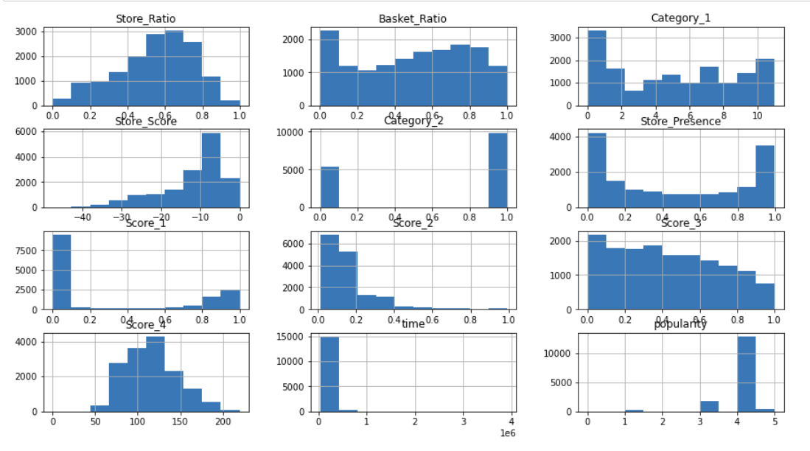
Exploratory Data Analysis
Histogram

Slide 7
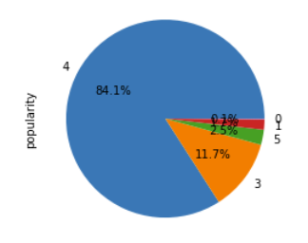
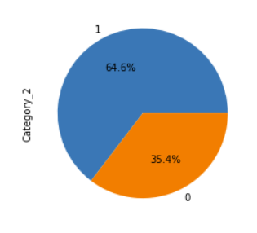
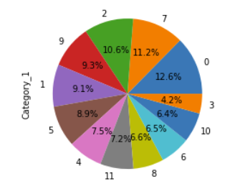
Exploratory Data Analysis
Pie chart distributions

Slide 8
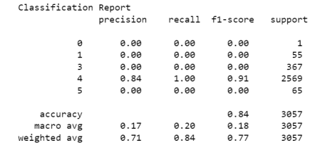
Methodology
Logistic Regression
It is a simple and easy to implement algorithm.
It can handle binary and multi class classification.
It is fast and efficient.
It can perform well with a small number of samples.
It provides interpretable results.

Slide 9
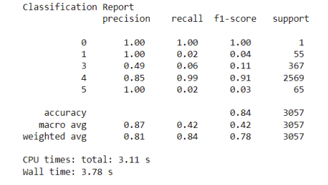
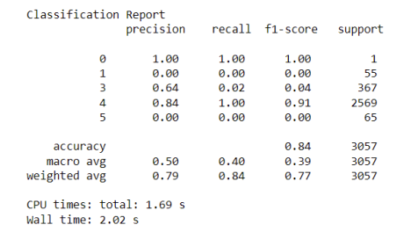
Methodology
Random Forest Classifier
Random Forest Classifier
Good generalization performance and can often achieve higher accuracy compared to single decision trees.
They can still provide some insight into the relative importance of different features in the model.
Fast training and prediction times.
Ability to handle large and high dimensional datasets.
Random Forest Classifier With Randomised CV Search

Slide 10
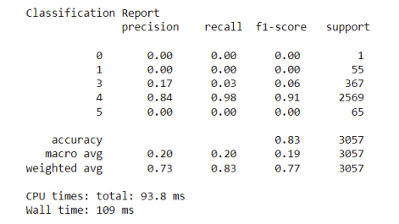
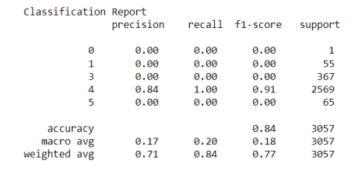
Methodology
K-Nearest Neighbors
K-Nearest Neighbors
Finding the K-nearest data points to a given data point
Classifying that data point based on the class of the majority of the K-nearest data points.
Computationally expensive.
Sensitive to the scale of the features.
Requires normalization of the data in order to work effectively.
K-Nearest Neighbors With Randomised CV Search

Slide 11
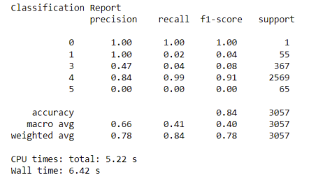
Methodology
Voting Classifier
Ensemble method that combines the predictions from multiple machine learning models and returns the prediction with the most votes.
It is a high bias low variance classifier.
We have defined a list of classifier objects called ’classifiers’ which consists of knn clf, svc, dt clf and rf clf. These are the models that will be used for voting.

Slide 12
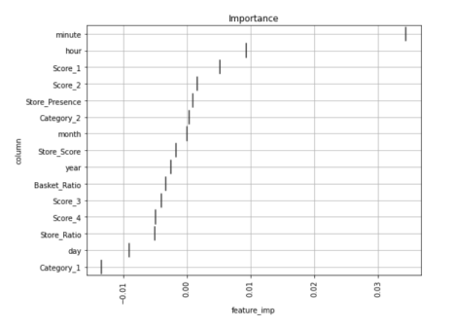
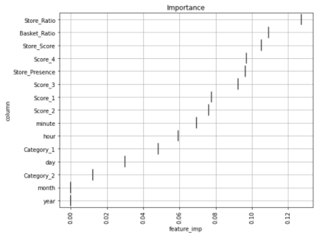
Methodology
Feature Importance
Logistic Regression
Random Forest Classifier

Slide 13
Conclusion:
We have used a variety of EDA techniques to deeply understand the data.
According to the classification reports, the Random Forest classifier, followed by the Voting classifier, Logistic Regression, and KNN, appears to have the best overall performance.
Achieved an accuracy of 84%.
In the case of popularity predictions, it predicted that the most important factor in determining the popularity of merchandise is the ”store ratio” attribute. The Random Forest Classifier provided us with the highest test result among the other algorithms we used.

Slide 14
Future Work:
References:
Expand dataset to contain more features that can best describe the target variable, i.e. Store ratio for predicting the popularity.
Research past solutions that have been applied.
Osiris ” Machine Hack ML Merchandise Popularity Prediction” kaggle competition.
Moutinho, Luiz, and Graeme D. Hutcheson. ”Store patronage: the utility of a multi-method, multi-nomial logistic regression model for predicting store choice.” Portuguese Journal of Management Studies 11.1 (2006): 5-26.
Speiser, Jaime Lynn, et al. ”A comparison of random forest variable selection methods for classification prediction modeling.” Expert systems with applications 134 (2019): 93-101.

Slide 15
THANK YOU
Stevens Institute of Technology
1 Castle Point Terrace, Hoboken, NJ 07030

